Slide 1
www.AsteroidsClub.org
Common Threats Make Common Ground
Notes:
--The asteroids club is all Americans who are willing to grant that both sides have legitimate concerns.
--In the asteroids club, we don’t start by searching for common ground. That’s often hard to find. We start by acknowledging common threats.
--Because common threats make common ground.
--So let us go to battle stations. Not to fight each other, but to start deflecting these incoming asteroids.
--And let our first mission be to press congress to fix itself,

Slide 2
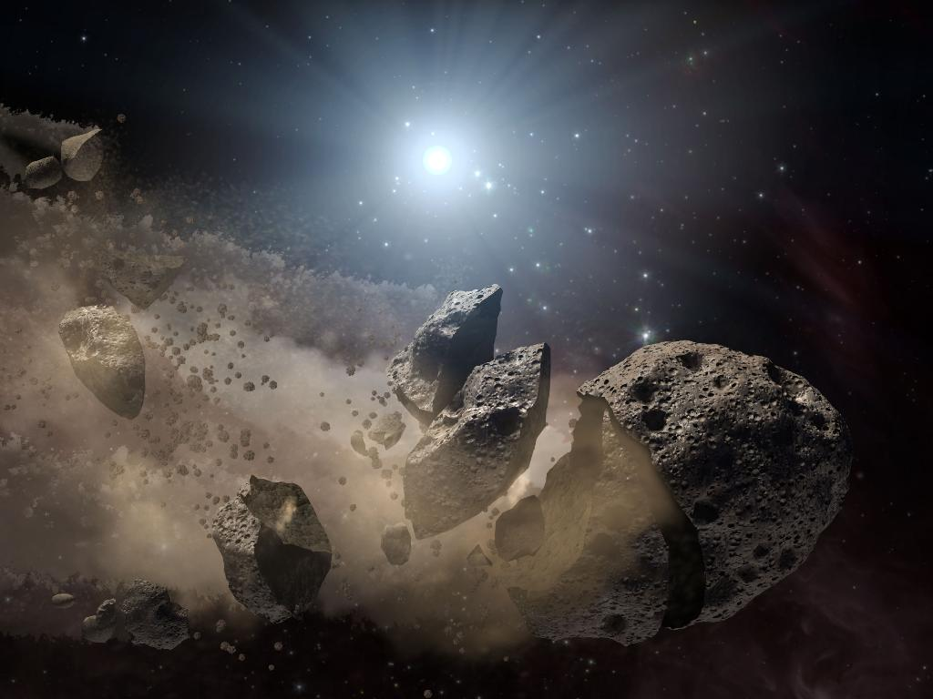
NASA.gov
Notes:
--If you’ve read the newspaper recently, you’ve heard the bad news. A pack of giant asteroids is headed our way, all scheduled to strike the United States in the next 50 years.
--I don’t mean asteroids made of rock. Those would be easy to deal with, because a common threat would unite us all, and we’d find a way to deflect the asteroids.
--No, I’m talking about four problems from hell, which come wrapped in a special energy field that polarizes us and paralyzes us.

Slide 3
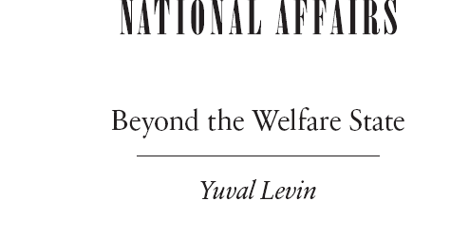
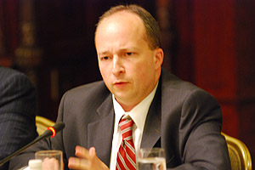
Asteroid: Entitlement Spending
Notes:
--where I knew I’d meet several conservative intellectuals, including Yuval Levin. To prepare for the dinner, I read an essay by Levin, in National Affairs, on the welfare state.
--Reading the essay was eerily like listening to Hansen’s lecture.
==>greece

Slide 4
“All over the world, nations are coming to terms with the fact that the social-democratic welfare state is turning out to be untenable and unaffordable, dependent upon dubious economics and the demographic model of a bygone era."
Notes:
--Levin wrote that “all over the world, nations are coming to terms with the fact that the social-democratic welfare state is turning out to be untenable and unaffordable, dependent upon dubious economics and the demographic model of a bygone era."
--That might not sound as scary as an asteroid, but Levin showed this graph from the Congressional Budget Office.
==>the graph, from CBO report

Slide 5
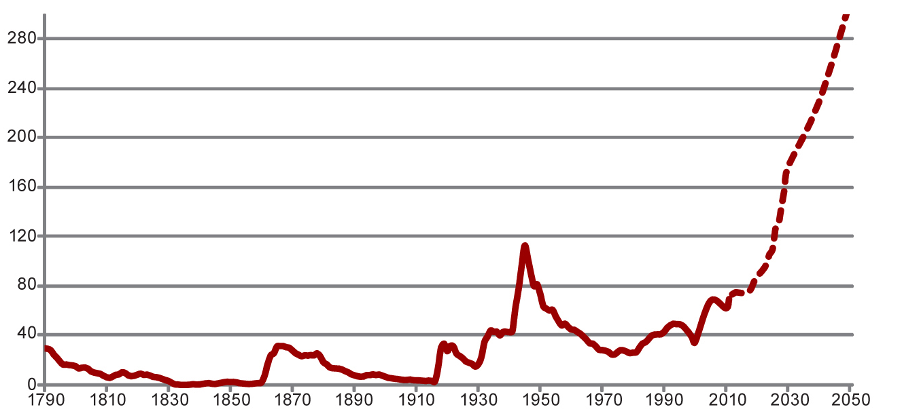
Federal Debt Held by the Public, 1790-2050
Revolutionary War
Debt as % of GDP
Source: Congressional Budget office, Alternative Fiscal Scenario
Notes:
--It shows federal debt as a % of GDP. You can see the huge spikes upward after each war.
==>To fight the revolutionary war, America borrowed money equivalent to about a third of its GDP. Then we gradually pay it off.
==>Civil war, same thing, about a third of GDP.

Slide 6
Federal Debt Held by the Public, 1790-2050
Civil War
Debt as % of GDP
Source: Congressional Budget office, Alternative Fiscal Scenario

Slide 7
Federal Debt Held by the Public, 1790-2050
WW-I
Debt as % of GDP
Source: Congressional Budget office, Alternative Fiscal Scenario

Slide 8
Federal Debt Held by the Public, 1790-2050
WW-II
Debt as % of GDP
Source: Congressional Budget office, Alternative Fiscal Scenario
Notes:
==>Here’s WW-II, following on the great depression.
--That one-two punch took us up to an astronomical 115% of GDP in debt.
==>current ??

Slide 9
Federal Debt Held by the Public, 1790-2050
???
Debt as % of GDP
Source: Congressional Budget office, Alternative Fiscal Scenario
Notes:
--what’s this? What’s this long rise since the 1970s?
--it’s partly the mess that George W. Bush made of the budget, but it’s mostly the steady rise of entitlement spending, mostly for the elderly.
-- We’re approaching levels of debt similar to those of WW-II, and the baby boomers haven’t even retired yet.
--And when they do,
==>reveal

Slide 10
Federal Debt Held by the Public, 1790-2050
Baby Boomer Retirement
Debt as % of GDP
Source: Congressional Budget office, Alternative Fiscal Scenario
Notes:
-- this is what will happen if we don’t make major changes.
--No nation can owe 3 times its GDP and survive.
--Entitlement spending is the second asteroid. The Right has been screaming about it since the 1960s, and the left is in denial.
--Liberals think we can pay for everything just by raising taxes on the rich.
3:00-------------------------------------------------------
--You might notice that this is more or less the same graph that Hansen showed.
==>graphs

Slide 11
Notes:
--What if there are so many incoming asteroids, we just can’t take the time to squabble.
--Because actually, we DO face this situation.
--I said earlier that there were four asteroids coming at us. Here are the remaining two.
==>1)rising inequality

Slide 12
www.AsteroidsClub.org
Common Threats Make Common Ground
Notes:
--The asteroids club is all Americans who are willing to grant that both sides have legitimate concerns.
--In the asteroids club, we don’t start by searching for common ground. That’s often hard to find. We start by acknowledging common threats.
--Because common threats make common ground.
--So let us go to battle stations. Not to fight each other, but to start deflecting these incoming asteroids.
--And let our first mission be to press congress to fix itself,

